Slide 1
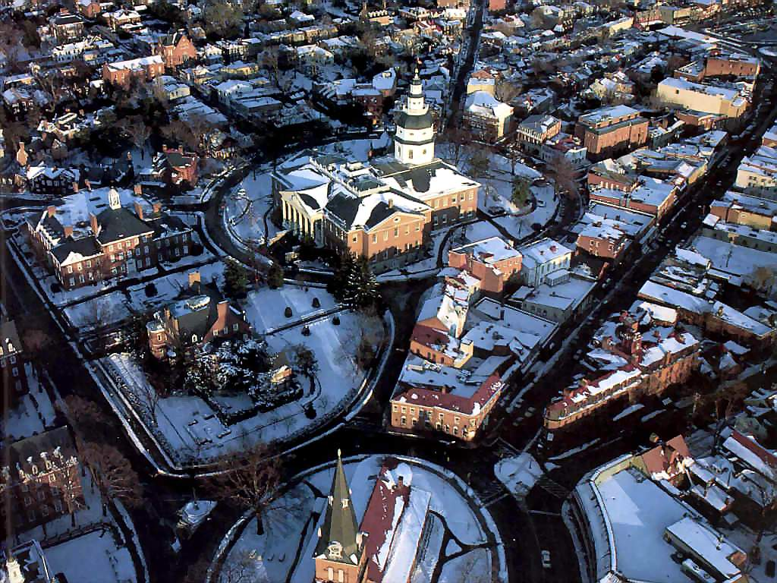
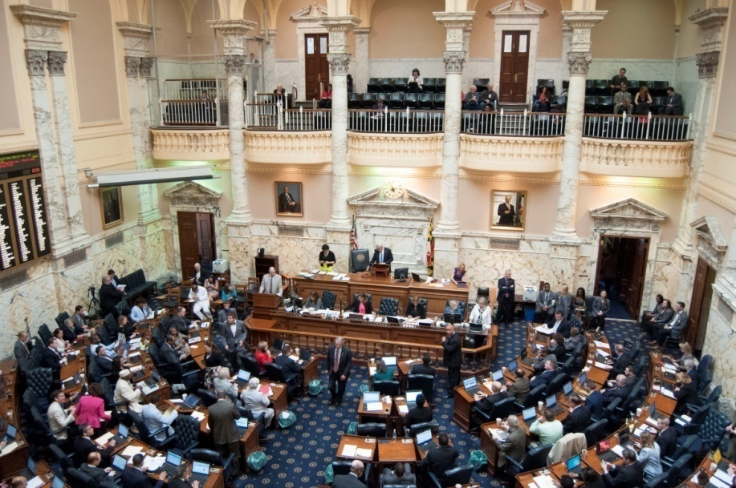
32nd Annual MD Joint Child Support Training Conference
2019 Legislative Briefing
DHS - Office of Government Affairs
October 23, 2019
Lauren C. Graziano, Director of Government Affairs

Slide 2
Agenda
Purpose: Provide overview of DHS-related enacted and prepare for the 2019 legislative session.
Introduction
DHS Overview
OGA – What We Do
2019 Legislation
  Overview of CSA Bills
2019 Interim and 2020 Session Forecasting
Discussion & Contact Information

Slide 3
DHS Overview
DHS is Maryland’s Human Services Agency.
  We envision a Maryland where people independently support themselves and their families and where individuals are safe from abuse and neglect.
3 Primary Areas:
  Administer the State’s Child Welfare and Adult Services Programs (Social Services Administration)
  Provide economic assistance to those in need (Family Investment Administration)
  Collect child support and support obligors in meeting obligations (Child Support Administration)
  In FY 2019, more than one million Marylanders used one or more DHS services.

Slide 4
OGA – What We Do
OGA serves as a coordination unit for all legislative and regulatory development activity for the Department.
The staff of OGA:
  coordinate the development and submission of departmental legislation;
  liaise with State, local and federal government officials to advance the departmental positions.
  facilitate briefings, committee hearings and the submission of statutorily mandated reports;
  coordinate responses to constituent concerns from elected officials; and
  manage the Department’s regulatory promulgation process.

Slide 5
2019 Legislation - Snapshot
Bills introduced
  2481 bills introduced in the House & Senate
    1051 in the Senate & 1430 in the House
    An over 20% decrease over last year’s record-setting volume of bills introduced:
      2016: 2,831
      2017: 2,880
      2018: 3,127
    It is unlikely we will see such few bills again. We can account for the low introduction rate due to the unprecedented number of new legislators.
  Passage rate: 22.9% (only 567 bills enacted)

Slide 6
CSA Legislation Passed and Failed
Bill Title | Bill No./Chapter No. | Sponsor | Pass/Fail | Effective Date
Child Support - Extraordinary Medical Expenses | HB0742 | Delegate Dumais | Pass | Oct 1, 2019
Family Law - Parentage and Adoption | HB519/SB697 | Delegate Dumais/Senator Smith | Pass | Jun 1, 2019
Child Support - Multifamily Adjustment and Deviation From Guidelines | HB0279/SB0639 | Delegate Dumais/ Senator Smith | Fail | N/A
Child Support - Potential Income, Voluntary Impoverishment, and No Support Order | HB0726/SB0762 | Delegate Dumais/Senator Smith | Fail | N/A
Child Support - Shared Physical Custody | HB0731/SB0638 | Delegate Dumais/Senator Smith | Fail | N/A
Child Support Guidelines - Revision | HB0732/SB0763 | Delegate Dumais/Senator Smith | Fail | N/A
Family Law - Child Support - Eligibility of a Child Who Has Attained the Age of 18 Years | HB0937 | Delegate Hill | Fail | N/A
Child Support - Lien Against Monetary Award | SB0023 | Departmental Legislation | Fail | N/A
Family Law - Paternity and Birth Certificates | HB0373 | Departmental Legislation | Fail | N/A

Slide 7
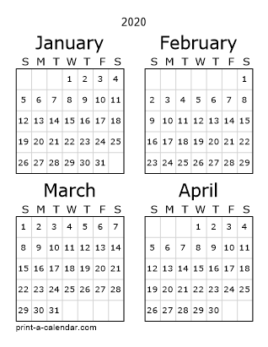
2020 General Assembly
January 8, 2020
General Assembly always convenes on the 2nd Wednesday of each January
Duration: 90 Days
April 6, 2020
90th Day – Adjournment “Sine Die” Monday

Slide 8
2019 Interim Issues of Interest
Possible Departmental Legislation
Responding to federal mandates
  Incarcerated Obligors
  Annual Federal Fee increase
Independent Contractors Legislation
Child Support Guidelines Committee Legislation
Consolidation of bills
  Combining Potential Income, Voluntary Impoverishment, and No Support Order with Guidelines Revisions
Reintroduction of Shared Physical Custody bill
Omitting Multi Family and Deviations bill—will revisit in a future session

Slide 9
Special Thanks
OGA would like to thank DHS Central Staff & Leadership, MASSD, Affiliates, Communications Team, Office of the Attorney General and MASSB for their ongoing support, technical assistance and counsel.

Slide 10

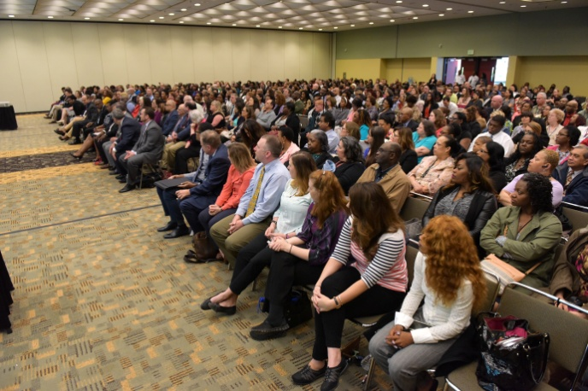

Discussion and Contact
Contact:
laurenc.graziano@maryland.gov
or
rachel.sledge@maryland.gov
www.dhr.state.md.us

